Slide 1
Car Price Prediction using Machine Learning
Team Orion
Eric Cheng, Hung Le, Babu Rajendran, Archana Shokeen, Tingjia Zhang

Slide 2
Introduction & Business Understanding
Car Purchases are significant ordeals for customers
Machine Learning helps provide knowledge to potential customers for best value purchases
Uses variables such as car model, age, price, depreciation to get price prediction

Slide 3
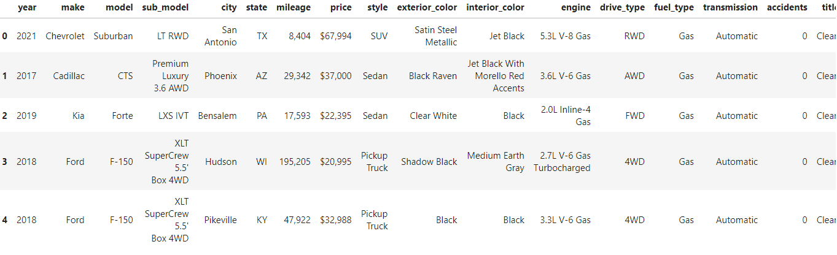
Data
Scraped Car data from online Car Resource website True Cars
Main columns are: [year, mileage, price, model, make]

Slide 4
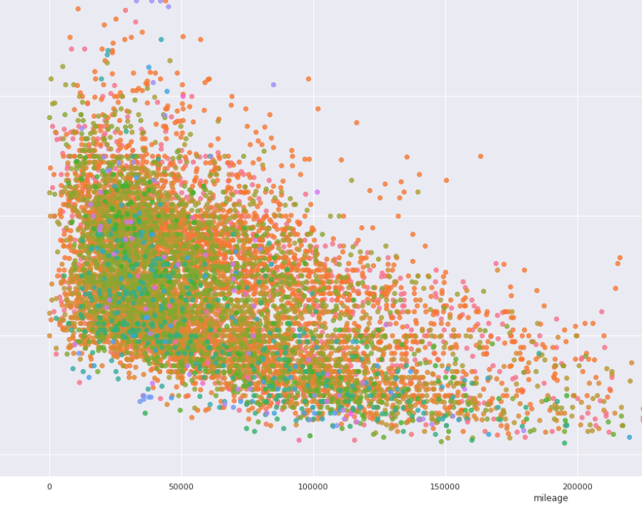
Methods
Preprocessing & Visualization
Feature Importance using Gini Score
KMeans Clustering
Finding the Golden Cluster
Regression Models:
Random Forest Regression

Slide 5
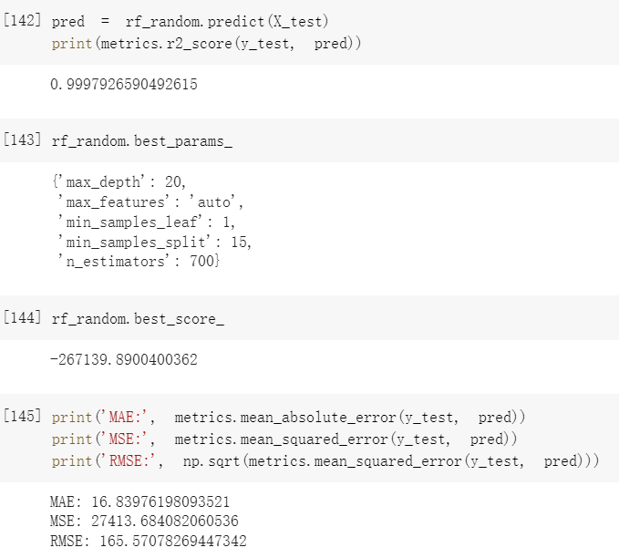
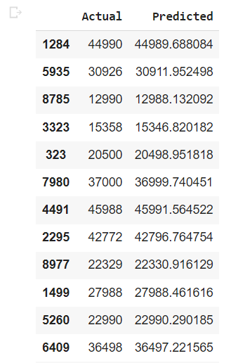
Experiments and Results

Slide 6
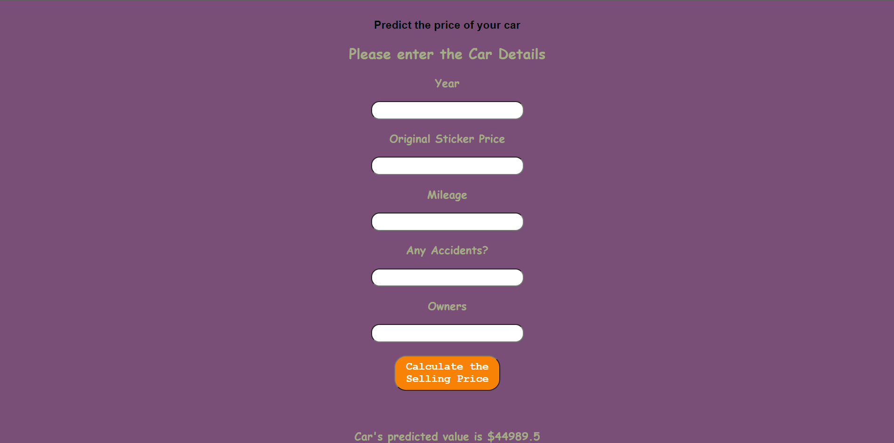
Deployment

